Slide 1
Informed Search Strategies

Slide 2
Learning objectives
5.1 Introduction
5.2 Hill Climbing
5.3 Best-first Search (Greedy Search)
5.4 A* Search
5.5 O* Search: (AND–OR) Graph
5.6 Memory Bounded Heuristic Search
5.6.1 Iterative Deepening A*
5.6.2 Recursive BFS
5.6.3 Simplified Memory Bounded A* (SMA*)
5.7 Simulated Annealing Search
5.8 Local Beam Search
5.9 Branch and Bound Search
After reading this chapter, the students will be able to:
To understand the concept of informed search (Heuristic Search).
To apply and evaluate the various problems using the fundamental of search.

Slide 3
Introduction
5.1 Introduction
5.2 Hill Climbing
5.3 Best-first Search (Greedy Search)
5.4 A* Search
5.5 O* Search: (AND–OR) Graph
5.6 Memory Bounded Heuristic Search
5.6.1 Iterative Deepening A*
5.6.2 Recursive BFS
5.6.3 Simplified Memory Bounded A* (SMA*)
5.7 Simulated Annealing Search
5.8 Local Beam Search
5.9 Branch and Bound Search
Strategies that know whether one goal state is more promising than the other are called heuristic/informed search techniques. These techniques work on the concept of heuristic and hence are also known as heuristic search techniques.
Direct techniques (blind search) are not always possible (they require too much time or memory).
Weak techniques can be effective if applied correctly on the right kinds of tasks.
Typically require domain specific information.

Slide 4
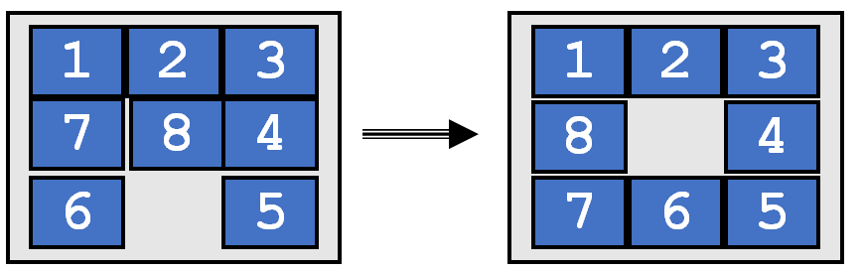
8 Puzzle Heuristics
5.1 Introduction
5.2 Hill Climbing
5.3 Best-first Search (Greedy Search)
5.4 A* Search
5.5 O* Search: (AND–OR) Graph
5.6 Memory Bounded Heuristic Search
5.6.1 Iterative Deepening A*
5.6.2 Recursive BFS
5.6.3 Simplified Memory Bounded A* (SMA*)
5.7 Simulated Annealing Search
5.8 Local Beam Search
5.9 Branch and Bound Search
The 8-puzzle is a small board game for a single player; it consists of eight square tiles
numbered 1 through 8 and one blank space on a 3 × 3 board moves of the puzzle are made by sliding an adjacent tile into the position occupied by the blank space, which has the effect of exchanging the positions of the tile and blank space. Only tiles that are horizontally or vertically adjacent (not diagonally adjacent) may be moved into the blank space.

Slide 5
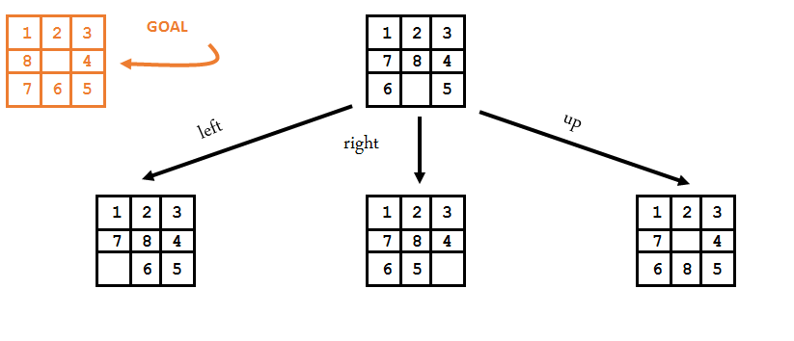
Which move is best?
5.1 Introduction
5.2 Hill Climbing
5.3 Best-first Search (Greedy Search)
5.4 A* Search
5.5 O* Search: (AND–OR) Graph
5.6 Memory Bounded Heuristic Search
5.6.1 Iterative Deepening A*
5.6.2 Recursive BFS
5.6.3 Simplified Memory Bounded A* (SMA*)
5.7 Simulated Annealing Search
5.8 Local Beam Search
5.9 Branch and Bound Search

Slide 6
8 Puzzle Heuristics
5.1 Introduction
5.2 Hill Climbing
5.3 Best-first Search (Greedy Search)
5.4 A* Search
5.5 O* Search: (AND–OR) Graph
5.6 Memory Bounded Heuristic Search
5.6.1 Iterative Deepening A*
5.6.2 Recursive BFS
5.6.3 Simplified Memory Bounded A* (SMA*)
5.7 Simulated Annealing Search
5.8 Local Beam Search
5.9 Branch and Bound Search
Blind search techniques used an arbitrary ordering (priority) of operations.
Heuristic search techniques make use of domain specific information - a heuristic.
What heurisitic(s) can we use to decide which 8-puzzle move is “best” (worth considering first).

Slide 7
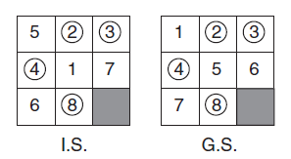
8 Puzzle Heuristics- Approach 1
5.1 Introduction
5.2 Hill Climbing
5.3 Best-first Search (Greedy Search)
5.4 A* Search
5.5 O* Search: (AND–OR) Graph
5.6 Memory Bounded Heuristic Search
5.6.1 Iterative Deepening A*
5.6.2 Recursive BFS
5.6.3 Simplified Memory Bounded A* (SMA*)
5.7 Simulated Annealing Search
5.8 Local Beam Search
5.9 Branch and Bound Search
Number of tiles in the Correct position.
The heuristic function of the game may be as follows: Count the number of tiles that are in place with respect to the goal state. Hence,
h(Initial State) = 4
As seen in the initial state, the number of tiles that are in the correct place with respect to the goal (Tiles 2, 3, 4 and 8 are in the same place as required in the goal state) state are four. Hence, the heuristic value for the initial state is 4 (Note, as a convention we do not consider the position of blank in the nongoal state).
h(Goal State) = 8
Heuristic value for the goal state will always be eight as all the tiles are in correct place in the goal state.

Slide 8
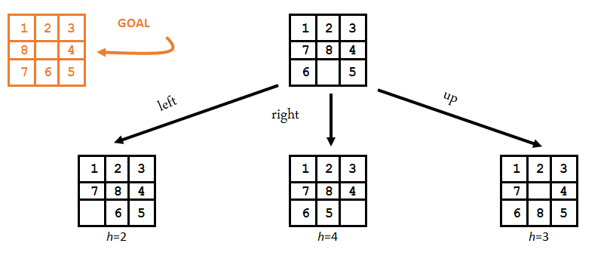
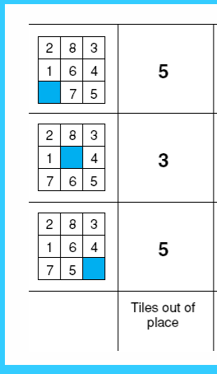
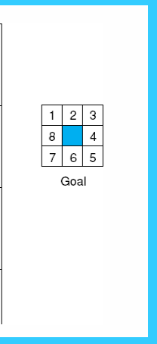
8 Puzzle Heuristics- Approach 2
5.1 Introduction
5.2 Hill Climbing
5.3 Best-first Search (Greedy Search)
5.4 A* Search
5.5 O* Search: (AND–OR) Graph
5.6 Memory Bounded Heuristic Search
5.6.1 Iterative Deepening A*
5.6.2 Recursive BFS
5.6.3 Simplified Memory Bounded A* (SMA*)
5.7 Simulated Annealing Search
5.8 Local Beam Search
5.9 Branch and Bound Search
Number of tiles in the incorrect position.
This can also be considered a lower bound on the number of moves from a solution!
The “best” move is the one with the lowest number returned by the heuristic.
Is this heuristic more than a heuristic (is it always correct?).
Given any 2 states, does it always order them properly with respect to the minimum number of moves away from a solution?

Slide 9
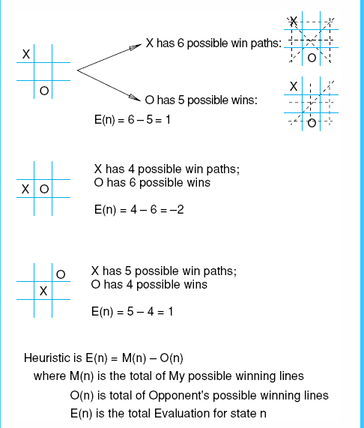
Heuristic for Tic-Tac-Toe Problem
5.1 Introduction
5.2 Hill Climbing
5.3 Best-first Search (Greedy Search)
5.4 A* Search
5.5 O* Search: (AND–OR) Graph
5.6 Memory Bounded Heuristic Search
5.6.1 Iterative Deepening A*
5.6.2 Recursive BFS
5.6.3 Simplified Memory Bounded A* (SMA*)
5.7 Simulated Annealing Search
5.8 Local Beam Search
5.9 Branch and Bound Search

Slide 10
Role of Heuristic in Informed Search
5.1 Introduction
5.2 Hill Climbing
5.3 Best-first Search (Greedy Search)
5.4 A* Search
5.5 O* Search: (AND–OR) Graph
5.6 Memory Bounded Heuristic Search
5.6.1 Iterative Deepening A*
5.6.2 Recursive BFS
5.6.3 Simplified Memory Bounded A* (SMA*)
5.7 Simulated Annealing Search
5.8 Local Beam Search
5.9 Branch and Bound Search

Slide 11
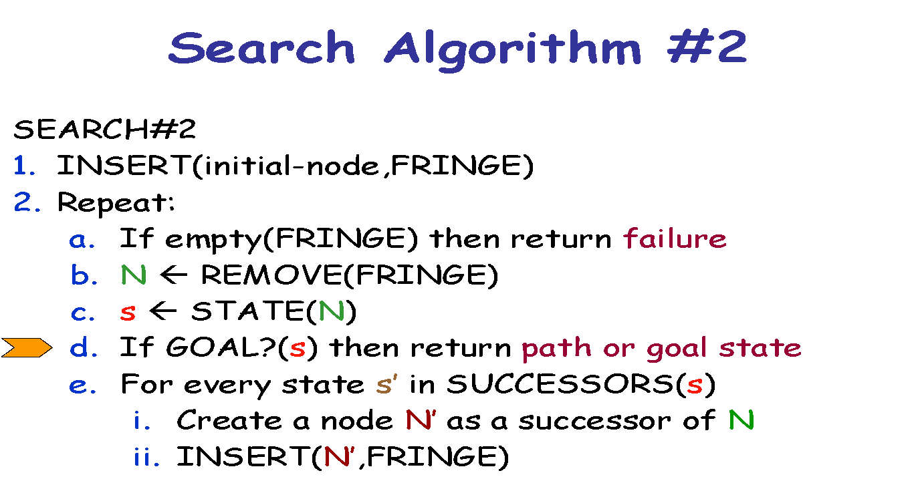
5.1 Introduction
5.2 Hill Climbing
5.3 Best-first Search (Greedy Search)
5.4 A* Search
5.5 O* Search: (AND–OR) Graph
5.6 Memory Bounded Heuristic Search
5.6.1 Iterative Deepening A*
5.6.2 Recursive BFS
5.6.3 Simplified Memory Bounded A* (SMA*)
5.7 Simulated Annealing Search
5.8 Local Beam Search
5.9 Branch and Bound Search
Recall that the ordering
of FRINGE defines the
search strategy

Slide 12
Best-First Search
5.1 Introduction
5.2 Hill Climbing
5.3 Best-first Search (Greedy Search)
5.4 A* Search
5.5 O* Search: (AND–OR) Graph
5.6 Memory Bounded Heuristic Search
5.6.1 Iterative Deepening A*
5.6.2 Recursive BFS
5.6.3 Simplified Memory Bounded A* (SMA*)
5.7 Simulated Annealing Search
5.8 Local Beam Search
5.9 Branch and Bound Search
It exploits state description to estimate how “good” each search node is
An evaluation function f maps each node N of the search tree to a real number f(N) ≥ 0 [Traditionally, f(N) is an estimated cost; so, the smaller f(N), the more promising N]
Best-first search sorts the FRINGE in increasing f [Arbitrary order is assumed among nodes with equal f]

Slide 13
Best-First Search
5.1 Introduction
5.2 Hill Climbing
5.3 Best-first Search (Greedy Search)
5.4 A* Search
5.5 O* Search: (AND–OR) Graph
5.6 Memory Bounded Heuristic Search
5.6.1 Iterative Deepening A*
5.6.2 Recursive BFS
5.6.3 Simplified Memory Bounded A* (SMA*)
5.7 Simulated Annealing Search
5.8 Local Beam Search
5.9 Branch and Bound Search
It exploits state description to estimate how “good” each search node is
An evaluation function f maps each node N of the search tree to a real number f(N) ≥ 0 [Traditionally, f(N) is an estimated cost; so, the smaller f(N), the more promising N]
Best-first search sorts the FRINGE in increasing f [Arbitrary order is assumed among nodes with equal f]
“Best” does not refer to the quality of the generated path
Best-first search does not generate
optimal paths in general

Slide 14
How to construct f?
5.1 Introduction
5.2 Hill Climbing
5.3 Best-first Search (Greedy Search)
5.4 A* Search
5.5 O* Search: (AND–OR) Graph
5.6 Memory Bounded Heuristic Search
5.6.1 Iterative Deepening A*
5.6.2 Recursive BFS
5.6.3 Simplified Memory Bounded A* (SMA*)
5.7 Simulated Annealing Search
5.8 Local Beam Search
5.9 Branch and Bound Search
Typically, f(N) estimates:
either the cost of a solution path through N
Then f(N) = g(N) + h(N), where
g(N) is the cost of the path from the initial node to N
h(N) is an estimate of the cost of a path from N to a goal node
or the cost of a path from N to a goal node
Then f(N) = h(N) 🡪 Greedy best-search
But there are no limitations on f. Any function of your choice is acceptable. But will it help the search algorithm?

Slide 15
How to construct f?
5.1 Introduction
5.2 Hill Climbing
5.3 Best-first Search (Greedy Search)
5.4 A* Search
5.5 O* Search: (AND–OR) Graph
5.6 Memory Bounded Heuristic Search
5.6.1 Iterative Deepening A*
5.6.2 Recursive BFS
5.6.3 Simplified Memory Bounded A* (SMA*)
5.7 Simulated Annealing Search
5.8 Local Beam Search
5.9 Branch and Bound Search
Typically, f(N) estimates:
either the cost of a solution path through N
Then f(N) = g(N) + h(N), where
g(N) is the cost of the path from the initial node to N
h(N) is an estimate of the cost of a path from N to a goal node
or the cost of a path from N to a goal node
Then f(N) = h(N)
But there are no limitations on f. Any function of your choice is acceptable. But will it help the search algorithm?
Heuristic function

Slide 16
Heuristic Function
5.1 Introduction
5.2 Hill Climbing
5.3 Best-first Search (Greedy Search)
5.4 A* Search
5.5 O* Search: (AND–OR) Graph
5.6 Memory Bounded Heuristic Search
5.6.1 Iterative Deepening A*
5.6.2 Recursive BFS
5.6.3 Simplified Memory Bounded A* (SMA*)
5.7 Simulated Annealing Search
5.8 Local Beam Search
5.9 Branch and Bound Search
The heuristic function h(N) ≥ 0 estimates the cost to go from STATE(N) to a goal state Its value is independent of the current search tree; it depends only on STATE(N) and the goal test GOAL?
Example:
h₁(N) = number of misplaced numbered tiles = 6
[Why is it an estimate of the distance to the goal?]
5
8
1
2
3
4
2
1
4
5
6
7
3
6
7
8
STATE(N)
Goal state

Slide 17
Other Examples
5.1 Introduction
5.2 Hill Climbing
5.3 Best-first Search (Greedy Search)
5.4 A* Search
5.5 O* Search: (AND–OR) Graph
5.6 Memory Bounded Heuristic Search
5.6.1 Iterative Deepening A*
5.6.2 Recursive BFS
5.6.3 Simplified Memory Bounded A* (SMA*)
5.7 Simulated Annealing Search
5.8 Local Beam Search
5.9 Branch and Bound Search
5
8
1
2
3
h₁(N) = number of misplaced numbered tiles = 6
h₂(N) = sum of the (Manhattan) distance of every numbered tile to its goal position = 2 + 3 + 0 + 1 + 3 + 0 + 3 + 1 = 13
h₃(N) = sum of permutation inversions = n₅ + n₈ + n₄ + n₂ + n₁ + n₇ + n₃ + n₆ = 4 + 6 + 3 + 1 + 0 + 2 + 0 + 0 = 16
4
2
1
4
5
6
7
3
6
7
8
STATE(N)
Goal state

Slide 18
Admissible Heuristic
5.1 Introduction
5.2 Hill Climbing
5.3 Best-first Search (Greedy Search)
5.4 A* Search
5.5 O* Search: (AND–OR) Graph
5.6 Memory Bounded Heuristic Search
5.6.1 Iterative Deepening A*
5.6.2 Recursive BFS
5.6.3 Simplified Memory Bounded A* (SMA*)
5.7 Simulated Annealing Search
5.8 Local Beam Search
5.9 Branch and Bound Search
Let h*(N) be the cost of the optimal path from N to a goal node
The heuristic function h(N) is admissible if: 0 ≤ h(N) ≤ h*(N)
An admissible heuristic function is always optimistic !

Slide 19
Admissible Heuristic
5.1 Introduction
5.2 Hill Climbing
5.3 Best-first Search (Greedy Search)
5.4 A* Search
5.5 O* Search: (AND–OR) Graph
5.6 Memory Bounded Heuristic Search
5.6.1 Iterative Deepening A*
5.6.2 Recursive BFS
5.6.3 Simplified Memory Bounded A* (SMA*)
5.7 Simulated Annealing Search
5.8 Local Beam Search
5.9 Branch and Bound Search
Let h*(N) be the cost of the optimal path from N to a goal node
The heuristic function h(N) is admissible if: 0 ≤ h(N) ≤ h*(N)
An admissible heuristic function is always optimistic !
G is a goal node 🡺 h(G) = 0

Slide 20
8-Puzzle Heuristics
5.1 Introduction
5.2 Hill Climbing
5.3 Best-first Search (Greedy Search)
5.4 A* Search
5.5 O* Search: (AND–OR) Graph
5.6 Memory Bounded Heuristic Search
5.6.1 Iterative Deepening A*
5.6.2 Recursive BFS
5.6.3 Simplified Memory Bounded A* (SMA*)
5.7 Simulated Annealing Search
5.8 Local Beam Search
5.9 Branch and Bound Search
h₂(N) = sum of the (Manhattan) distances of every tile to its goal position = 2 + 3 + 0 + 1 + 3 + 0 + 3 + 1 = 13 is admissible
h₃(N) = sum of permutation inversions = 4 + 6 + 3 + 1 + 0 + 2 + 0 + 0 = 16 is not admissible
5
8
1
2
3
4
2
1
4
5
6
7
3
6
7
8
STATE(N)
Goal state

Slide 21
8-Puzzle Heuristics
5.1 Introduction
5.2 Hill Climbing
5.3 Best-first Search (Greedy Search)
5.4 A* Search
5.5 O* Search: (AND–OR) Graph
5.6 Memory Bounded Heuristic Search
5.6.1 Iterative Deepening A*
5.6.2 Recursive BFS
5.6.3 Simplified Memory Bounded A* (SMA*)
5.7 Simulated Annealing Search
5.8 Local Beam Search
5.9 Branch and Bound Search
h₁(N) = number of misplaced tiles = 6 is admissible
h₂(N) = sum of the (Manhattan) distances of every tile to its goal position = 2 + 3 + 0 + 1 + 3 + 0 + 3 + 1 = 13 is ???
h₃(N) = sum of permutation inversions = 4 + 6 + 3 + 1 + 0 + 2 + 0 + 0 = 16 is not admissible
5
8
1
2
3
4
2
1
4
5
6
7
3
6
7
8
STATE(N)
Goal state

Slide 22
8-Puzzle Heuristics
5.1 Introduction
5.2 Hill Climbing
5.3 Best-first Search (Greedy Search)
5.4 A* Search
5.5 O* Search: (AND–OR) Graph
5.6 Memory Bounded Heuristic Search
5.6.1 Iterative Deepening A*
5.6.2 Recursive BFS
5.6.3 Simplified Memory Bounded A* (SMA*)
5.7 Simulated Annealing Search
5.8 Local Beam Search
5.9 Branch and Bound Search
h₁(N) = number of misplaced tiles = 6 is admissible
h₂(N) = sum of the (Manhattan) distances of every tile to its goal position = 2 + 3 + 0 + 1 + 3 + 0 + 3 + 1 = 13 is admissible
h₃(N) = sum of permutation inversions = 4 + 6 + 3 + 1 + 0 + 2 + 0 + 0 = 16 is ???
5
8
1
2
3
4
2
1
4
5
6
7
3
6
7
8
STATE(N)
Goal state

Slide 23
8-Puzzle Heuristics
5.1 Introduction
5.2 Hill Climbing
5.3 Best-first Search (Greedy Search)
5.4 A* Search
5.5 O* Search: (AND–OR) Graph
5.6 Memory Bounded Heuristic Search
5.6.1 Iterative Deepening A*
5.6.2 Recursive BFS
5.6.3 Simplified Memory Bounded A* (SMA*)
5.7 Simulated Annealing Search
5.8 Local Beam Search
5.9 Branch and Bound Search
h₁(N) = number of misplaced tiles = 6 is admissible
h₂(N) = sum of the (Manhattan) distances of every tile to its goal position = 2 + 3 + 0 + 1 + 3 + 0 + 3 + 1 = 13 is admissible
h₃(N) = sum of permutation inversions = 4 + 6 + 3 + 1 + 0 + 2 + 0 + 0 = 16 is not admissible
5
8
1
2
3
4
2
1
4
5
6
7
3
6
7
8
STATE(N)
Goal state

Slide 24
5.1 Introduction
5.2 Hill Climbing
5.3 Best-first Search (Greedy Search)
5.4 A* Search
5.5 O* Search: (AND–OR) Graph
5.6 Memory Bounded Heuristic Search
5.6.1 Iterative Deepening A*
5.6.2 Recursive BFS
5.6.3 Simplified Memory Bounded A* (SMA*)
5.7 Simulated Annealing Search
5.8 Local Beam Search
5.9 Branch and Bound Search
Hill climbing search algorithm is simply a loop that continuously moves in the direction of increasing value.
It stops when it reaches a “peak” where no neighbour has higher value. This algorithm is considered to be one of the simplest procedures for implementing heuristic search. The hill climbing comes from the idea that if you are trying to find the top of the hill and you go up direction from wherever you are.
This heuristic combines the advantages of both depth-first and breadth-first searches into a single method.

Slide 25
Types of Hill Climbing
5.1 Introduction
5.2 Hill Climbing
5.3 Best-first Search (Greedy Search)
5.4 A* Search
5.5 O* Search: (AND–OR) Graph
5.6 Memory Bounded Heuristic Search
5.6.1 Iterative Deepening A*
5.6.2 Recursive BFS
5.6.3 Simplified Memory Bounded A* (SMA*)
5.7 Simulated Annealing Search
5.8 Local Beam Search
5.9 Branch and Bound Search
Simple Hill Climbing
It examines the neighbouring nodes one-by-one and selects the first neighbouring node which optimises the current cost as
Steepest-ascent Hill Climbing
At first examines all the neighbouring nodes and then selects the node closest to the solution state as the next nodenext node.
Stochastic Hill Climbing
It does not examine all the neighbouring nodes before deciding which node to select. It just selects a neighbouring node at random, and decides (based on the amount of improvement in that neighbour) whether to move to that neighbour or to examine another.

Slide 26
5.1 Introduction
5.2 Hill Climbing
5.3 Best-first Search (Greedy Search)
5.4 A* Search
5.5 O* Search: (AND–OR) Graph
5.6 Memory Bounded Heuristic Search
5.6.1 Iterative Deepening A*
5.6.2 Recursive BFS
5.6.3 Simplified Memory Bounded A* (SMA*)
5.7 Simulated Annealing Search
5.8 Local Beam Search
5.9 Branch and Bound Search
Begin
/*Initially OPEN contains the root node and CLOSE is EMPTY*/
OPEN=[start]
CLOSE=[]
/*We Continue the loop till OPEN list is not EMPTY*/
While OPEN≠[] do
Begin
Remove the left most state from OPEN and call it X
If X=GOAL then
Return SUCCESS
Else
Begin
1. Generate children of X
2. Put X on close
3. Discard the children of X if already on OPEN or CLOSE
4. Sort the remaining Children according to the heuristic value of each state
5. Put the children on left side of OPEN in sorted order.
/*Note that the children are sorted first according to the heuristic merit and are then put to the left sideof OPEN*/
End
End
Return Fail
End
The algorithm described is called as steepest ascent hill climbing.

Slide 27
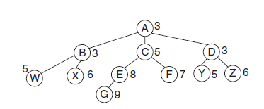
5.1 Introduction
5.2 Hill Climbing
5.3 Best-first Search (Greedy Search)
5.4 A* Search
5.5 O* Search: (AND–OR) Graph
5.6 Memory Bounded Heuristic Search
5.6.1 Iterative Deepening A*
5.6.2 Recursive BFS
5.6.3 Simplified Memory Bounded A* (SMA*)
5.7 Simulated Annealing Search
5.8 Local Beam Search
5.9 Branch and Bound Search
Apply hill climbing to the following tree considering G is the Goal State and Node A as the initial state.
Step 1: The hill climbing algorithm starts with the initial state.
OPEN = [A3]
CLOSE = []
Note that leftmost node in the OPEN list is Node A, and hence, we expand Node A in the next step.

Slide 28

5.1 Introduction
5.2 Hill Climbing
5.3 Best-first Search (Greedy Search)
5.4 A* Search
5.5 O* Search: (AND–OR) Graph
5.6 Memory Bounded Heuristic Search
5.6.1 Iterative Deepening A*
5.6.2 Recursive BFS
5.6.3 Simplified Memory Bounded A* (SMA*)
5.7 Simulated Annealing Search
5.8 Local Beam Search
5.9 Branch and Bound Search
Apply hill climbing to the following tree considering G is the Goal State and Node A as the initial state.
Step 2: All the children of Node A are now generated.
OPEN = [C5, B3, D3]
CLOSE = [A]
Note that the leftmost node in the OPEN list is Node C. Hence, we expand Node C in Step 3.

Slide 29
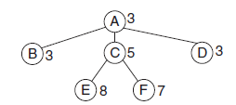
5.1 Introduction
5.2 Hill Climbing
5.3 Best-first Search (Greedy Search)
5.4 A* Search
5.5 O* Search: (AND–OR) Graph
5.6 Memory Bounded Heuristic Search
5.6.1 Iterative Deepening A*
5.6.2 Recursive BFS
5.6.3 Simplified Memory Bounded A* (SMA*)
5.7 Simulated Annealing Search
5.8 Local Beam Search
5.9 Branch and Bound Search
Apply hill climbing to the following tree considering G is the Goal State and Node A as the initial state.
Step 3: Amongst all the children of Node root Node A Node C has the highest heuristic. Hence, all the children of Node C are now generated.
OPEN = [E8, F7, B3, D3]
CLOSE = [A, C]
Note that leftmost node in OPEN list is Node E. Hence, we expand Node E in Step 4.

Slide 30
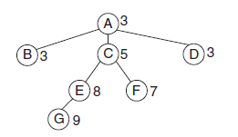
5.1 Introduction
5.2 Hill Climbing
5.3 Best-first Search (Greedy Search)
5.4 A* Search
5.5 O* Search: (AND–OR) Graph
5.6 Memory Bounded Heuristic Search
5.6.1 Iterative Deepening A*
5.6.2 Recursive BFS
5.6.3 Simplified Memory Bounded A* (SMA*)
5.7 Simulated Annealing Search
5.8 Local Beam Search
5.9 Branch and Bound Search
Apply hill climbing to the following tree considering G is the Goal State and Node A as the initial state.
Step 4: Now the algorithm proceeds towards Node E and among all the children of Node E (only G is the child of Node C). Node G has a highest Heuristic merit; and hence, Node G is generated.
OPEN = [G9, F7, B3, D3]
CLOSE = [A, C, E]
Note that the leftmost node in OPEN list is Node G and Node G is a GOAL and hence we STOP

Slide 31
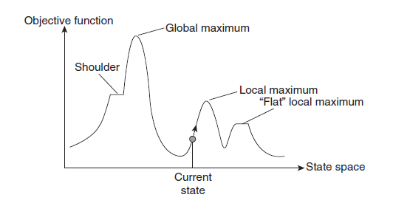
Demerits of Hill Climbing
5.1 Introduction
5.2 Hill Climbing
5.3 Best-first Search (Greedy Search)
5.4 A* Search
5.5 O* Search: (AND–OR) Graph
5.6 Memory Bounded Heuristic Search
5.6.1 Iterative Deepening A*
5.6.2 Recursive BFS
5.6.3 Simplified Memory Bounded A* (SMA*)
5.7 Simulated Annealing Search
5.8 Local Beam Search
5.9 Branch and Bound Search
State–space diagram is a graphical representation of the set of states our search algorithm can reach versus
the value of our objective function (the function which we wish to maximise).
X-axis: It denotes the state space, that is, states or configuration our algorithm may reach.
Y-axis: It denotes the values of objective function corresponding to a particular state. The best solution will be that state space where objective function has maximum value (global maximum).

Slide 32
Different Regions in the State–Space Diagram
5.1 Introduction
5.2 Hill Climbing
5.3 Best-first Search (Greedy Search)
5.4 A* Search
5.5 O* Search: (AND–OR) Graph
5.6 Memory Bounded Heuristic Search
5.6.1 Iterative Deepening A*
5.6.2 Recursive BFS
5.6.3 Simplified Memory Bounded A* (SMA*)
5.7 Simulated Annealing Search
5.8 Local Beam Search
5.9 Branch and Bound Search
1. Local maximum: It is a state which is better than its neighbouring state. However, there exists a state which is better than it (global maximum). This state is better because here value of objective function is higher than its neighbours.
2. Global maximum: It is the best possible state in the state–space diagram. This because at this state, objective function has the highest value.
3. Plateau/Flat local maximum: It is a flat region of state space where neighbouring states have the same value.
4. Ridge: It is region which is higher than its neighbours but itself has a slope. It is a special kind of local maximum.
5. Current state: The region of state–space diagram, where we are currently present during the search.
6. Shoulder: It is a plateau that has an uphill edge.

Slide 33
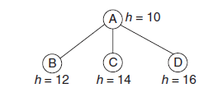
Problems in Different Regions in Hill climbing
5.1 Introduction
5.2 Hill Climbing
5.3 Best-first Search (Greedy Search)
5.4 A* Search
5.5 O* Search: (AND–OR) Graph
5.6 Memory Bounded Heuristic Search
5.6.1 Iterative Deepening A*
5.6.2 Recursive BFS
5.6.3 Simplified Memory Bounded A* (SMA*)
5.7 Simulated Annealing Search
5.8 Local Beam Search
5.9 Branch and Bound Search
1. Local maximum: At a local maximum all neighbouring states having a values, which is worse than the current state. Since, hill climbing uses greedy approach, it will not move to the worse state and terminate itself. The process will end even though a better solution may exist.
To overcome local maximum problem Solution to the problem are:
(a) One possible solution is backtracking.
We can backtrack to some earlier node and try to go in a different direction to attain the global peak. We can maintain a list of paths almost taken and go back to one of them if the path that was taken leads to a dead end.
(b) Another solution can be a list of promising plan.

Slide 34
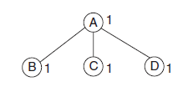
5.1 Introduction
5.2 Hill Climbing
5.3 Best-first Search (Greedy Search)
5.4 A* Search
5.5 O* Search: (AND–OR) Graph
5.6 Memory Bounded Heuristic Search
5.6.1 Iterative Deepening A*
5.6.2 Recursive BFS
5.6.3 Simplified Memory Bounded A* (SMA*)
5.7 Simulated Annealing Search
5.8 Local Beam Search
5.9 Branch and Bound Search
Problems in Different Regions in Hill climbing
2. Plateau: On plateau all neighbours have same value. Hence, it is not possible to select the best direction. Plateau is a flat area of the search space in which a whole set of neighbouring states has the value. On a plateau, it is not possible to determine the best direction in which to move the local comparisons.
To overcome plateaus:
(a) A big jump in some direction can be done in order to get to a new section of search space. This method is recommended as in a plateau all neighbouring points have the same value.
(b) Another solution is to apply small steps several times in the same direction. This depends on the rules available.

Slide 35
Problems in Different Regions in Hill climbing
5.1 Introduction
5.2 Hill Climbing
5.3 Best-first Search (Greedy Search)
5.4 A* Search
5.5 O* Search: (AND–OR) Graph
5.6 Memory Bounded Heuristic Search
5.6.1 Iterative Deepening A*
5.6.2 Recursive BFS
5.6.3 Simplified Memory Bounded A* (SMA*)
5.7 Simulated Annealing Search
5.8 Local Beam Search
5.9 Branch and Bound Search
3. Ridge: Any point on a ridge can look like peak because movement in all possible directions is downwards. Hence, the algorithm stops when it reaches this state.
To overcome plateaus:
(a) A big jump in some direction can be done in order to get to a new section of search space. This method is recommended as in a plateau all neighbouring points have the same value.
(b) Another solution is to apply small steps several times in the same direction. This depends on the rules available.

Slide 36
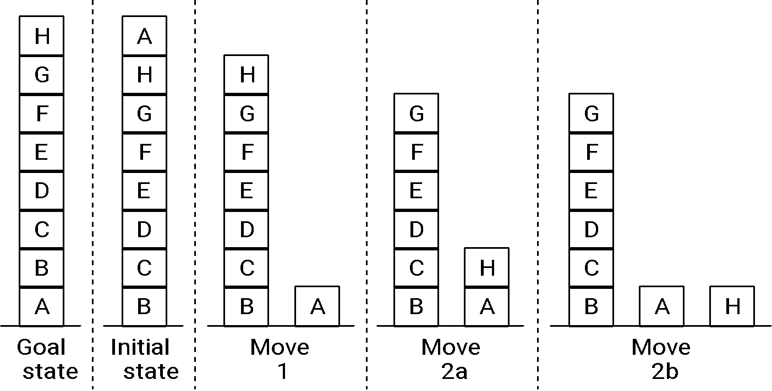
A hill climbing example
5.1 Introduction
5.2 Hill Climbing
5.3 Best-first Search (Greedy Search)
5.4 A* Search
5.5 O* Search: (AND–OR) Graph
5.6 Memory Bounded Heuristic Search
5.6.1 Iterative Deepening A*
5.6.2 Recursive BFS
5.6.3 Simplified Memory Bounded A* (SMA*)
5.7 Simulated Annealing Search
5.8 Local Beam Search
5.9 Branch and Bound Search

Slide 37
A hill climbing example
5.1 Introduction
5.2 Hill Climbing
5.3 Best-first Search (Greedy Search)
5.4 A* Search
5.5 O* Search: (AND–OR) Graph
5.6 Memory Bounded Heuristic Search
5.6.1 Iterative Deepening A*
5.6.2 Recursive BFS
5.6.3 Simplified Memory Bounded A* (SMA*)
5.7 Simulated Annealing Search
5.8 Local Beam Search
5.9 Branch and Bound Search
A local heuristic function
Count +1 for every block that sits on the correct thing. The goal state has the value +8.
Count -1 for every block that sits on an incorrect thing. In the initial state blocks C, D, E, F, G, H count +1 each. Blocks A, B count -1 each , for the total of +4.
Move 1 gives the value +6 (A is now on the correct support). Moves 2a and 2b both give +4 (B and H are wrongly situated). This means we have a local maximum of +6.

Slide 38
A hill climbing example
5.1 Introduction
5.2 Hill Climbing
5.3 Best-first Search (Greedy Search)
5.4 A* Search
5.5 O* Search: (AND–OR) Graph
5.6 Memory Bounded Heuristic Search
5.6.1 Iterative Deepening A*
5.6.2 Recursive BFS
5.6.3 Simplified Memory Bounded A* (SMA*)
5.7 Simulated Annealing Search
5.8 Local Beam Search
5.9 Branch and Bound Search
A global heuristic function
Count +N for every block that sits on a correct stack of N things. The goal state has the value +28.
Count -N for every block that sits on an incorrect stack of N things. That is, there is a large penalty for blocks tied up in a wrong structure.
In the initial state C, D, E, F, G, H count -1, -2, -3, -4, -5, -6. A counts -7 , for the total of -28.
continued

Slide 39
A hill climbing example
5.1 Introduction
5.2 Hill Climbing
5.3 Best-first Search (Greedy Search)
5.4 A* Search
5.5 O* Search: (AND–OR) Graph
5.6 Memory Bounded Heuristic Search
5.6.1 Iterative Deepening A*
5.6.2 Recursive BFS
5.6.3 Simplified Memory Bounded A* (SMA*)
5.7 Simulated Annealing Search
5.8 Local Beam Search
5.9 Branch and Bound Search
Move 1 gives the value -21 (A is now on the correct support).
Move 2a gives -16, because C, D, E, F, G, H count -1, -2, -3, -4, -5, -1.
Move 2b gives -15, because C, D, E, F, G count -1, -2, -3, -4, -5.
There is no local maximum!
Moral: sometimes changing the heuristic function is all we need.

Slide 40
Greedy best-first search
5.1 Introduction
5.2 Hill Climbing
5.3 Best-first Search (Greedy Search)
5.4 A* Search
5.5 O* Search: (AND–OR) Graph
5.6 Memory Bounded Heuristic Search
5.6.1 Iterative Deepening A*
5.6.2 Recursive BFS
5.6.3 Simplified Memory Bounded A* (SMA*)
5.7 Simulated Annealing Search
5.8 Local Beam Search
5.9 Branch and Bound Search
f(n) = estimate of cost from n to goal
e.g., f_{SLD}(n) = straight-line distance from n to Bucharest
Greedy best-first search expands the node that appears to be closest to goal.

Slide 41
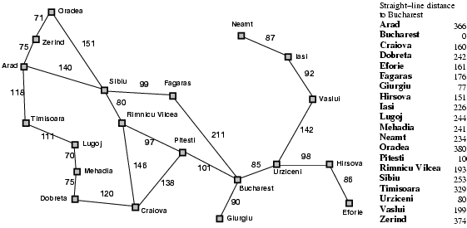
Romania with straight-line dist.
5.1 Introduction
5.2 Hill Climbing
5.3 Best-first Search (Greedy Search)
5.4 A* Search
5.5 O* Search: (AND–OR) Graph
5.6 Memory Bounded Heuristic Search
5.6.1 Iterative Deepening A*
5.6.2 Recursive BFS
5.6.3 Simplified Memory Bounded A* (SMA*)
5.7 Simulated Annealing Search
5.8 Local Beam Search
5.9 Branch and Bound Search

Slide 42

Greedy best-first search example
5.1 Introduction
5.2 Hill Climbing
5.3 Best-first Search (Greedy Search)
5.4 A* Search
5.5 O* Search: (AND–OR) Graph
5.6 Memory Bounded Heuristic Search
5.6.1 Iterative Deepening A*
5.6.2 Recursive BFS
5.6.3 Simplified Memory Bounded A* (SMA*)
5.7 Simulated Annealing Search
5.8 Local Beam Search
5.9 Branch and Bound Search

Slide 43
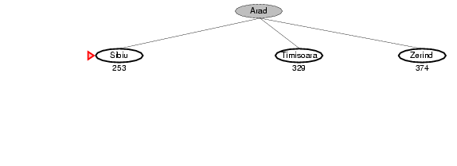
Greedy best-first search example
5.1 Introduction
5.2 Hill Climbing
5.3 Best-first Search (Greedy Search)
5.4 A* Search
5.5 O* Search: (AND–OR) Graph
5.6 Memory Bounded Heuristic Search
5.6.1 Iterative Deepening A*
5.6.2 Recursive BFS
5.6.3 Simplified Memory Bounded A* (SMA*)
5.7 Simulated Annealing Search
5.8 Local Beam Search
5.9 Branch and Bound Search

Slide 44
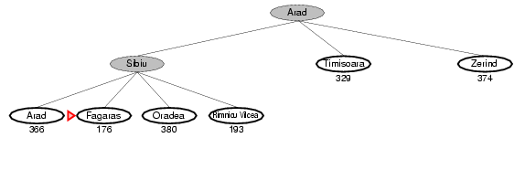
Greedy best-first search example
5.1 Introduction
5.2 Hill Climbing
5.3 Best-first Search (Greedy Search)
5.4 A* Search
5.5 O* Search: (AND–OR) Graph
5.6 Memory Bounded Heuristic Search
5.6.1 Iterative Deepening A*
5.6.2 Recursive BFS
5.6.3 Simplified Memory Bounded A* (SMA*)
5.7 Simulated Annealing Search
5.8 Local Beam Search
5.9 Branch and Bound Search

Slide 45
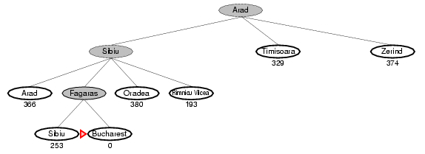
Greedy best-first search example
5.1 Introduction
5.2 Hill Climbing
5.3 Best-first Search (Greedy Search)
5.4 A* Search
5.5 O* Search: (AND–OR) Graph
5.6 Memory Bounded Heuristic Search
5.6.1 Iterative Deepening A*
5.6.2 Recursive BFS
5.6.3 Simplified Memory Bounded A* (SMA*)
5.7 Simulated Annealing Search
5.8 Local Beam Search
5.9 Branch and Bound Search

Slide 46
Properties of greedy best-first search
5.1 Introduction
5.2 Hill Climbing
5.3 Best-first Search (Greedy Search)
5.4 A* Search
5.5 O* Search: (AND–OR) Graph
5.6 Memory Bounded Heuristic Search
5.6.1 Iterative Deepening A*
5.6.2 Recursive BFS
5.6.3 Simplified Memory Bounded A* (SMA*)
5.7 Simulated Annealing Search
5.8 Local Beam Search
5.9 Branch and Bound Search
Complete? No – can get stuck in loops.
Time? O(b^{m}), but a good heuristic can give dramatic improvement
Space? O(b^{m}) - keeps all nodes in memory
Optimal? No
e.g. Arad🡪Sibiu🡪Rimnicu Virea🡪Pitesti🡪Bucharest is shorter!

Slide 47
A* search
5.1 Introduction
5.2 Hill Climbing
5.3 Best-first Search (Greedy Search)
5.4 A* Search
5.5 O* Search: (AND–OR) Graph
5.6 Memory Bounded Heuristic Search
5.6.1 Iterative Deepening A*
5.6.2 Recursive BFS
5.6.3 Simplified Memory Bounded A* (SMA*)
5.7 Simulated Annealing Search
5.8 Local Beam Search
5.9 Branch and Bound Search
Idea: avoid expanding paths that are already expensive
Evaluation function f(n) = g(n) + h(n)
g(n) = cost so far to reach n
h(n) = estimated cost from n to goal
f(n) = estimated total cost of path through n to goal
Best First search has f(n)=h(n)

Slide 48

A* search example
5.1 Introduction
5.2 Hill Climbing
5.3 Best-first Search (Greedy Search)
5.4 A* Search
5.5 O* Search: (AND–OR) Graph
5.6 Memory Bounded Heuristic Search
5.6.1 Iterative Deepening A*
5.6.2 Recursive BFS
5.6.3 Simplified Memory Bounded A* (SMA*)
5.7 Simulated Annealing Search
5.8 Local Beam Search
5.9 Branch and Bound Search

Slide 49
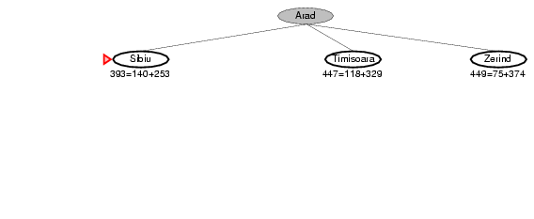
A* search example
5.1 Introduction
5.2 Hill Climbing
5.3 Best-first Search (Greedy Search)
5.4 A* Search
5.5 O* Search: (AND–OR) Graph
5.6 Memory Bounded Heuristic Search
5.6.1 Iterative Deepening A*
5.6.2 Recursive BFS
5.6.3 Simplified Memory Bounded A* (SMA*)
5.7 Simulated Annealing Search
5.8 Local Beam Search
5.9 Branch and Bound Search

Slide 50
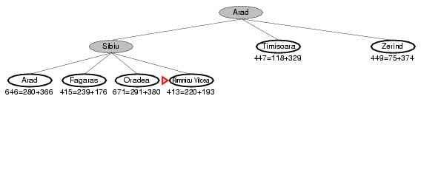
A* search example
5.1 Introduction
5.2 Hill Climbing
5.3 Best-first Search (Greedy Search)
5.4 A* Search
5.5 O* Search: (AND–OR) Graph
5.6 Memory Bounded Heuristic Search
5.6.1 Iterative Deepening A*
5.6.2 Recursive BFS
5.6.3 Simplified Memory Bounded A* (SMA*)
5.7 Simulated Annealing Search
5.8 Local Beam Search
5.9 Branch and Bound Search

Slide 51
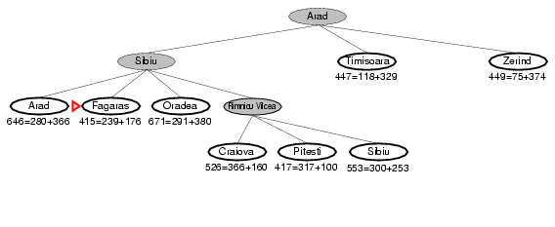
A* search example
5.1 Introduction
5.2 Hill Climbing
5.3 Best-first Search (Greedy Search)
5.4 A* Search
5.5 O* Search: (AND–OR) Graph
5.6 Memory Bounded Heuristic Search
5.6.1 Iterative Deepening A*
5.6.2 Recursive BFS
5.6.3 Simplified Memory Bounded A* (SMA*)
5.7 Simulated Annealing Search
5.8 Local Beam Search
5.9 Branch and Bound Search

Slide 52
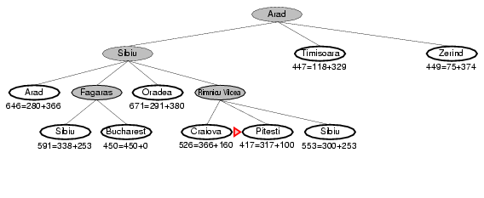
A* search example
5.1 Introduction
5.2 Hill Climbing
5.3 Best-first Search (Greedy Search)
5.4 A* Search
5.5 O* Search: (AND–OR) Graph
5.6 Memory Bounded Heuristic Search
5.6.1 Iterative Deepening A*
5.6.2 Recursive BFS
5.6.3 Simplified Memory Bounded A* (SMA*)
5.7 Simulated Annealing Search
5.8 Local Beam Search
5.9 Branch and Bound Search

Slide 53
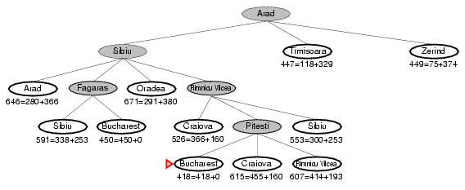
A* search example
5.1 Introduction
5.2 Hill Climbing
5.3 Best-first Search (Greedy Search)
5.4 A* Search
5.5 O* Search: (AND–OR) Graph
5.6 Memory Bounded Heuristic Search
5.6.1 Iterative Deepening A*
5.6.2 Recursive BFS
5.6.3 Simplified Memory Bounded A* (SMA*)
5.7 Simulated Annealing Search
5.8 Local Beam Search
5.9 Branch and Bound Search

Slide 54
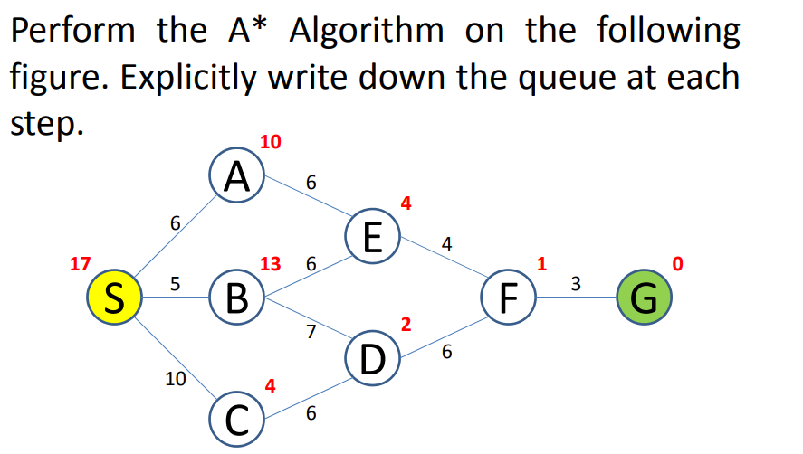
5.1 Introduction
5.2 Hill Climbing
5.3 Best-first Search (Greedy Search)
5.4 A* Search
5.5 O* Search: (AND–OR) Graph
5.6 Memory Bounded Heuristic Search
5.6.1 Iterative Deepening A*
5.6.2 Recursive BFS
5.6.3 Simplified Memory Bounded A* (SMA*)
5.7 Simulated Annealing Search
5.8 Local Beam Search
5.9 Branch and Bound Search

Slide 55
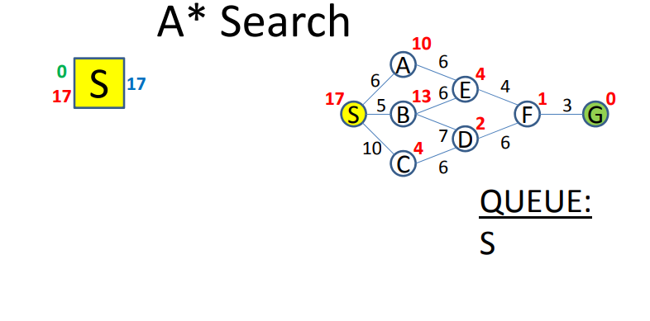
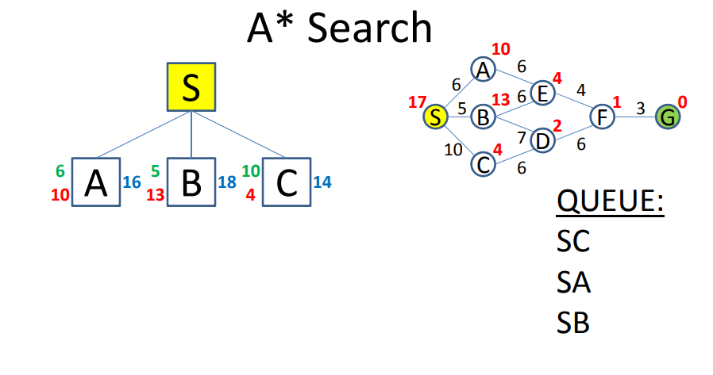
5.1 Introduction
5.2 Hill Climbing
5.3 Best-first Search (Greedy Search)
5.4 A* Search
5.5 O* Search: (AND–OR) Graph
5.6 Memory Bounded Heuristic Search
5.6.1 Iterative Deepening A*
5.6.2 Recursive BFS
5.6.3 Simplified Memory Bounded A* (SMA*)
5.7 Simulated Annealing Search
5.8 Local Beam Search
5.9 Branch and Bound Search

Slide 56
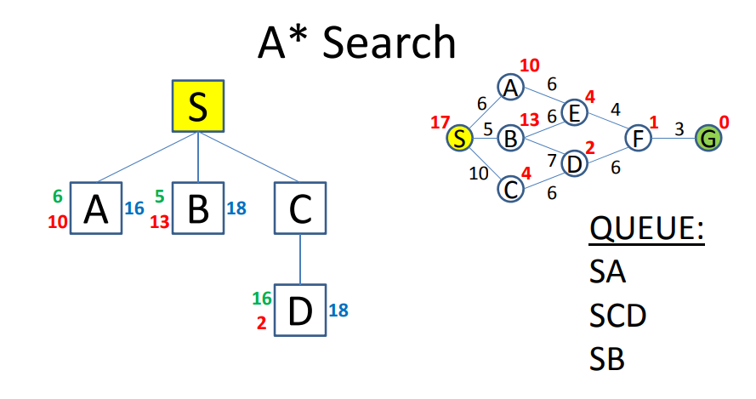
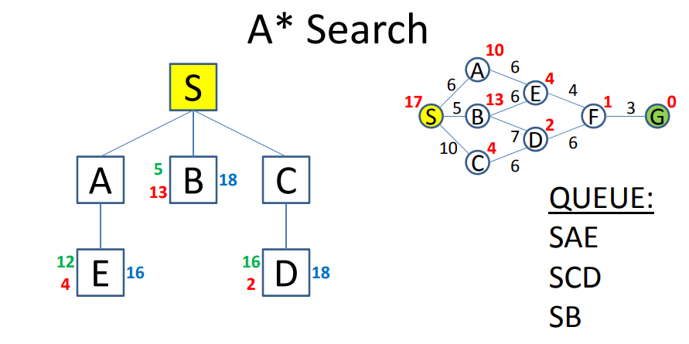
5.1 Introduction
5.2 Hill Climbing
5.3 Best-first Search (Greedy Search)
5.4 A* Search
5.5 O* Search: (AND–OR) Graph
5.6 Memory Bounded Heuristic Search
5.6.1 Iterative Deepening A*
5.6.2 Recursive BFS
5.6.3 Simplified Memory Bounded A* (SMA*)
5.7 Simulated Annealing Search
5.8 Local Beam Search
5.9 Branch and Bound Search
5.1 Introduction
5.2 Hill Climbing
5.3 Best-first Search (Greedy Search)
5.4 A* Search
5.5 O* Search: (AND–OR) Graph
5.6 Memory Bounded Heuristic Search
5.6.1 Iterative Deepening A*
5.6.2 Recursive BFS
5.6.3 Simplified Memory Bounded A* (SMA*)
5.7 Simulated Annealing Search
5.8 Local Beam Search
5.9 Branch and Bound Search

Slide 57
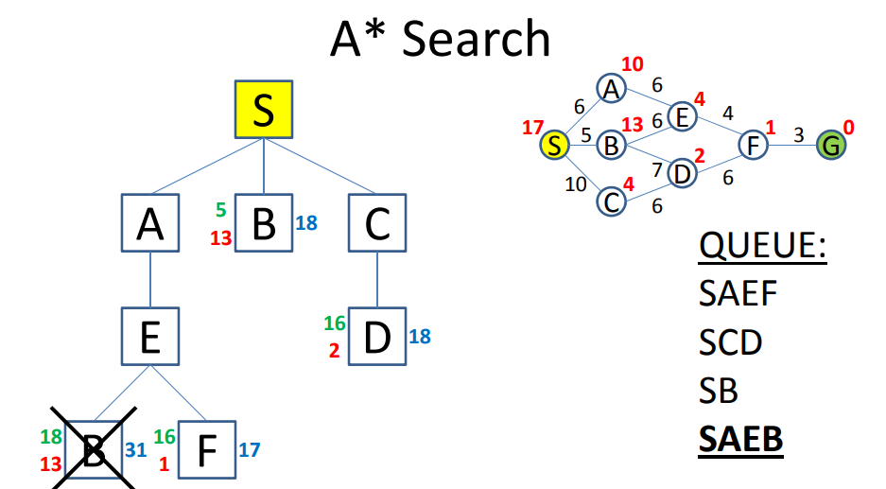
5.1 Introduction
5.2 Hill Climbing
5.3 Best-first Search (Greedy Search)
5.4 A* Search
5.5 O* Search: (AND–OR) Graph
5.6 Memory Bounded Heuristic Search
5.6.1 Iterative Deepening A*
5.6.2 Recursive BFS
5.6.3 Simplified Memory Bounded A* (SMA*)
5.7 Simulated Annealing Search
5.8 Local Beam Search
5.9 Branch and Bound Search

Slide 58
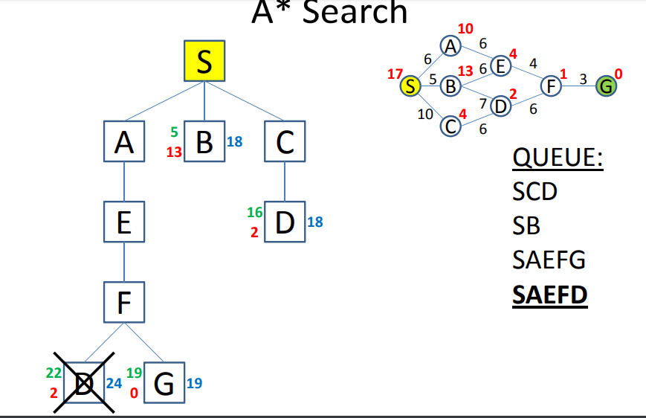
5.1 Introduction
5.2 Hill Climbing
5.3 Best-first Search (Greedy Search)
5.4 A* Search
5.5 O* Search: (AND–OR) Graph
5.6 Memory Bounded Heuristic Search
5.6.1 Iterative Deepening A*
5.6.2 Recursive BFS
5.6.3 Simplified Memory Bounded A* (SMA*)
5.7 Simulated Annealing Search
5.8 Local Beam Search
5.9 Branch and Bound Search

Slide 59
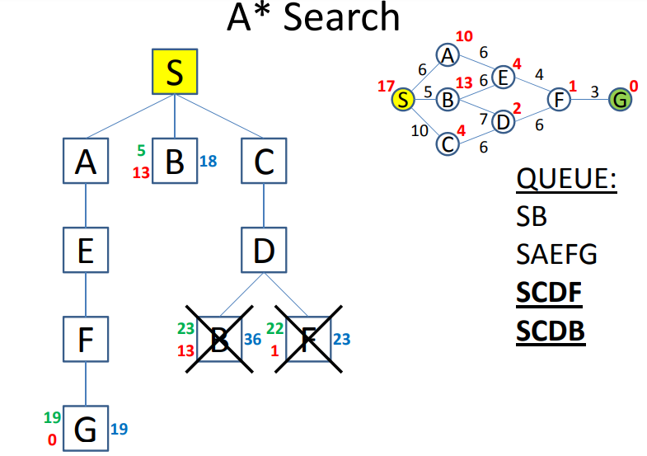
5.1 Introduction
5.2 Hill Climbing
5.3 Best-first Search (Greedy Search)
5.4 A* Search
5.5 O* Search: (AND–OR) Graph
5.6 Memory Bounded Heuristic Search
5.6.1 Iterative Deepening A*
5.6.2 Recursive BFS
5.6.3 Simplified Memory Bounded A* (SMA*)
5.7 Simulated Annealing Search
5.8 Local Beam Search
5.9 Branch and Bound Search

Slide 60
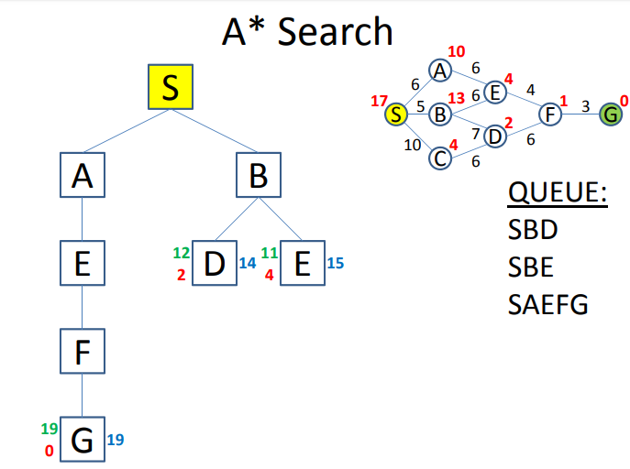
5.1 Introduction
5.2 Hill Climbing
5.3 Best-first Search (Greedy Search)
5.4 A* Search
5.5 O* Search: (AND–OR) Graph
5.6 Memory Bounded Heuristic Search
5.6.1 Iterative Deepening A*
5.6.2 Recursive BFS
5.6.3 Simplified Memory Bounded A* (SMA*)
5.7 Simulated Annealing Search
5.8 Local Beam Search
5.9 Branch and Bound Search

Slide 61
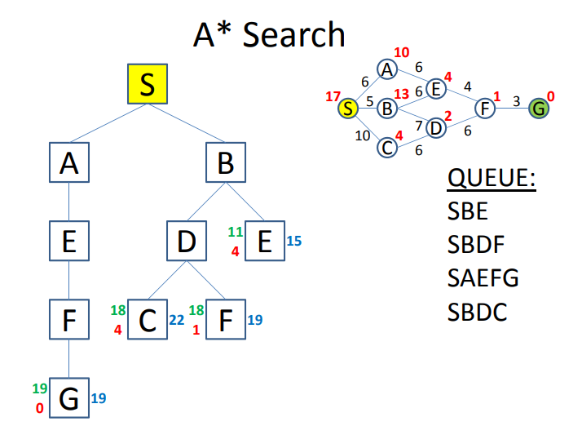
5.1 Introduction
5.2 Hill Climbing
5.3 Best-first Search (Greedy Search)
5.4 A* Search
5.5 O* Search: (AND–OR) Graph
5.6 Memory Bounded Heuristic Search
5.6.1 Iterative Deepening A*
5.6.2 Recursive BFS
5.6.3 Simplified Memory Bounded A* (SMA*)
5.7 Simulated Annealing Search
5.8 Local Beam Search
5.9 Branch and Bound Search

Slide 62
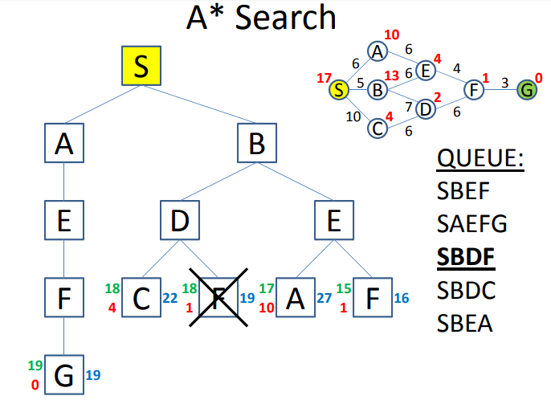
5.1 Introduction
5.2 Hill Climbing
5.3 Best-first Search (Greedy Search)
5.4 A* Search
5.5 O* Search: (AND–OR) Graph
5.6 Memory Bounded Heuristic Search
5.6.1 Iterative Deepening A*
5.6.2 Recursive BFS
5.6.3 Simplified Memory Bounded A* (SMA*)
5.7 Simulated Annealing Search
5.8 Local Beam Search
5.9 Branch and Bound Search

Slide 63
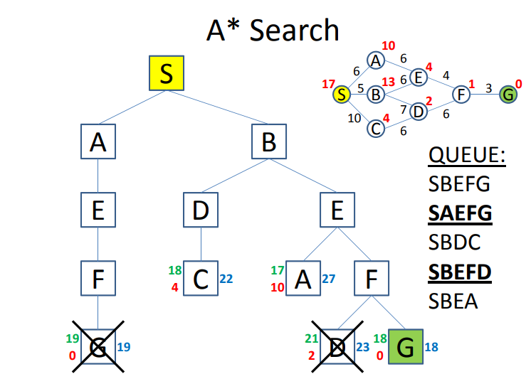
5.1 Introduction
5.2 Hill Climbing
5.3 Best-first Search (Greedy Search)
5.4 A* Search
5.5 O* Search: (AND–OR) Graph
5.6 Memory Bounded Heuristic Search
5.6.1 Iterative Deepening A*
5.6.2 Recursive BFS
5.6.3 Simplified Memory Bounded A* (SMA*)
5.7 Simulated Annealing Search
5.8 Local Beam Search
5.9 Branch and Bound Search

Slide 64
Admissible heuristics
5.1 Introduction
5.2 Hill Climbing
5.3 Best-first Search (Greedy Search)
5.4 A* Search
5.5 O* Search: (AND–OR) Graph
5.6 Memory Bounded Heuristic Search
5.6.1 Iterative Deepening A*
5.6.2 Recursive BFS
5.6.3 Simplified Memory Bounded A* (SMA*)
5.7 Simulated Annealing Search
5.8 Local Beam Search
5.9 Branch and Bound Search
A heuristic h(n) is admissible if for every node n,
h(n) ≤ h*(n), where h*(n) is the true cost to reach the goal state from n.
An admissible heuristic never overestimates the cost to reach the goal, i.e., it is optimistic
Example: h_{SLD}(n) (never overestimates the actual road distance)
Theorem: If h(n) is admissible, A* using TREE-SEARCH is optimal

Slide 65
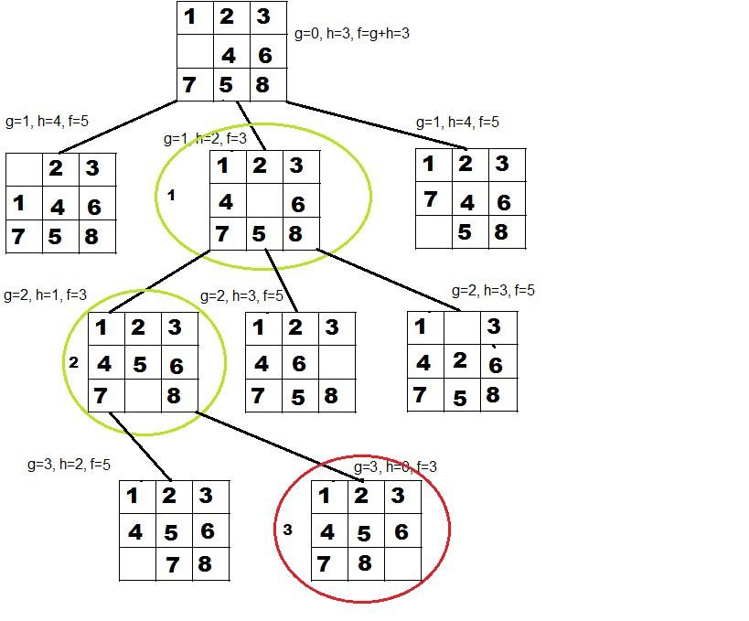
Puzzle problem using A*
5.1 Introduction
5.2 Hill Climbing
5.3 Best-first Search (Greedy Search)
5.4 A* Search
5.5 O* Search: (AND–OR) Graph
5.6 Memory Bounded Heuristic Search
5.6.1 Iterative Deepening A*
5.6.2 Recursive BFS
5.6.3 Simplified Memory Bounded A* (SMA*)
5.7 Simulated Annealing Search
5.8 Local Beam Search
5.9 Branch and Bound Search

Slide 66
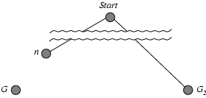
Optimality of A* (proof)
5.1 Introduction
5.2 Hill Climbing
5.3 Best-first Search (Greedy Search)
5.4 A* Search
5.5 O* Search: (AND–OR) Graph
5.6 Memory Bounded Heuristic Search
5.6.1 Iterative Deepening A*
5.6.2 Recursive BFS
5.6.3 Simplified Memory Bounded A* (SMA*)
5.7 Simulated Annealing Search
5.8 Local Beam Search
5.9 Branch and Bound Search
Suppose some suboptimal goal G₂ has been generated and is in the fringe. Let n be an unexpanded node in the fringe such that n is on a shortest path to an optimal goal G.
f(G₂) = g(G₂) since h(G₂) = 0
f(G) = g(G) since h(G) = 0
g(G₂) > g(G) since G₂ is suboptimal
f(G₂) > f(G) from above
We want to prove:
f(n) < f(G2)
(then A* will prefer n over G2)

Slide 67
Optimality of A* (proof)
5.1 Introduction
5.2 Hill Climbing
5.3 Best-first Search (Greedy Search)
5.4 A* Search
5.5 O* Search: (AND–OR) Graph
5.6 Memory Bounded Heuristic Search
5.6.1 Iterative Deepening A*
5.6.2 Recursive BFS
5.6.3 Simplified Memory Bounded A* (SMA*)
5.7 Simulated Annealing Search
5.8 Local Beam Search
5.9 Branch and Bound Search
Suppose some suboptimal goal G₂ has been generated and is in the fringe. Let n be an unexpanded node in the fringe such that n is on a shortest path to an optimal goal G.
f(G₂) > f(G) copied from last slide
h(n) ≤ h*(n) since h is admissible (under-estimate)
g(n) + h(n) ≤ g(n) + h*(n) from above
f(n) ≤ f(G) since g(n)+h(n)=f(n) & g(n)+h*(n)=f(G)
f(n) < f(G2) from top line.
Hence: n is preferred over G2

Slide 68
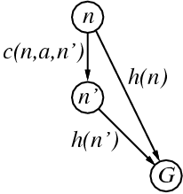
Consistent heuristics
5.1 Introduction
5.2 Hill Climbing
5.3 Best-first Search (Greedy Search)
5.4 A* Search
5.5 O* Search: (AND–OR) Graph
5.6 Memory Bounded Heuristic Search
5.6.1 Iterative Deepening A*
5.6.2 Recursive BFS
5.6.3 Simplified Memory Bounded A* (SMA*)
5.7 Simulated Annealing Search
5.8 Local Beam Search
5.9 Branch and Bound Search
A heuristic is consistent if for every node n, every successor n' of n generated by any action a,
h(n) ≤ c(n,a,n') + h(n')
If h is consistent, we have
f(n') = g(n') + h(n')
= g(n) + c(n,a,n') + h(n')
≥ g(n) + h(n) = f(n)
f(n’) ≥ f(n)
i.e., f(n) is non-decreasing along any path.
Theorem:
If h(n) is consistent, A* using GRAPH-SEARCH is optimal
It’s the triangle
inequality !
keeps all checked nodes
in memory to avoid repeated
states

Slide 69
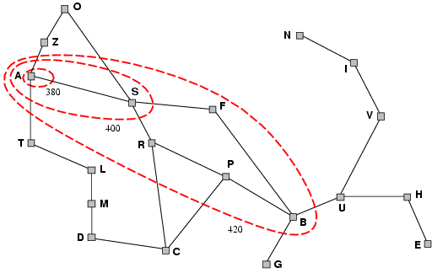
Optimality of A*
5.1 Introduction
5.2 Hill Climbing
5.3 Best-first Search (Greedy Search)
5.4 A* Search
5.5 O* Search: (AND–OR) Graph
5.6 Memory Bounded Heuristic Search
5.6.1 Iterative Deepening A*
5.6.2 Recursive BFS
5.6.3 Simplified Memory Bounded A* (SMA*)
5.7 Simulated Annealing Search
5.8 Local Beam Search
5.9 Branch and Bound Search
A* expands nodes in order of increasing f value
Gradually adds "f-contours" of nodes
Contour i contains all nodes with f≤f_{i} where f_{i} < f_{i+1}

Slide 70
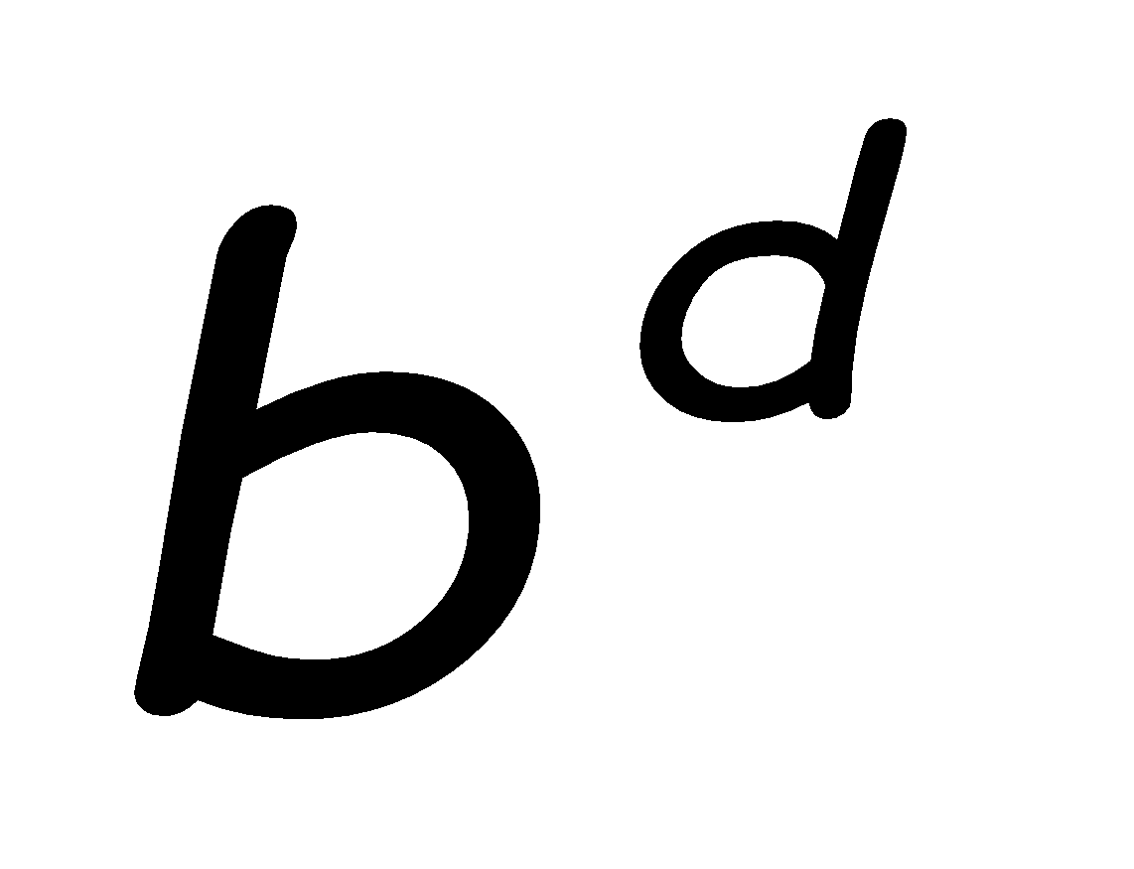
Properties of A*
5.1 Introduction
5.2 Hill Climbing
5.3 Best-first Search (Greedy Search)
5.4 A* Search
5.5 O* Search: (AND–OR) Graph
5.6 Memory Bounded Heuristic Search
5.6.1 Iterative Deepening A*
5.6.2 Recursive BFS
5.6.3 Simplified Memory Bounded A* (SMA*)
5.7 Simulated Annealing Search
5.8 Local Beam Search
5.9 Branch and Bound Search
Complete? Yes (unless there are infinitely many nodes with f ≤ f(G) , i.e. path-cost > ε)
Time/Space? Exponential
except if:
Optimal? Yes
Optimally Efficient: Yes (no algorithm with the
same heuristic is guaranteed to expand fewer nodes)

Slide 71
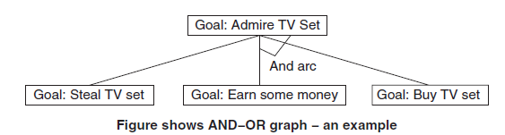
And-Or Graph
5.1 Introduction
5.2 Hill Climbing
5.3 Best-first Search (Greedy Search)
5.4 A* Search
5.5 AO* Search: (AND–OR) Graph
5.6 Memory Bounded Heuristic Search
5.6.1 Iterative Deepening A*
5.6.2 Recursive BFS
5.6.3 Simplified Memory Bounded A* (SMA*)
5.7 Simulated Annealing Search
5.8 Local Beam Search
5.9 Branch and Bound Search
When a problem can be divided into a set of sub problems, where each sub problem can be solved separately and a combination of these will be a solution, AND-OR graphs or AND - OR trees are used for representing the solution. The decomposition of the problem or problem reduction generates AND arcs. One AND are may point to any number of successor nodes. All these must be solved so that the arc will rise to many arcs, indicating several possible solutions. Hence the graph is known as AND - OR instead of AND. Figure shows an AND - OR graph.

Slide 72
AO* Algorithm
5.1 Introduction
5.2 Hill Climbing
5.3 Best-first Search (Greedy Search)
5.4 A* Search
5.5 AO* Search: (AND–OR) Graph
5.6 Memory Bounded Heuristic Search
5.6.1 Iterative Deepening A*
5.6.2 Recursive BFS
5.6.3 Simplified Memory Bounded A* (SMA*)
5.7 Simulated Annealing Search
5.8 Local Beam Search
5.9 Branch and Bound Search
1. Let G consists only to the node representing the initial state call this node INTT. Compute h’ (INIT).
2. Until INIT is labelled SOLVED or hi (INIT) becomes greater than FUTILITY, repeat the following procedure.
(a) Trace the marked arcs from INIT and select an unbounded node NODE.
(b) Generate the successors of NODE. if there are no successors then assign FUTILITY as h’
(NODE). This means that NODE is not solvable. If there are successors then for each one called SUCCESSOR, that is not also an ancestor of NODE do the following:
• Add SUCCESSOR to graph G.
• If successor is not a terminal node, mark it solved and assign zero to its h’ value.
• If successor is not a terminal node, compute it h’ value.
(c) Propagate the newly discovered information up the graph by doing the following:
– Let S be a set of nodes that have been marked SOLVED. Initialise S to NODE. Until S is empty repeat the following procedure;
– Select a node from S call if CURRENT and remove it from S.
– Compute h’ of each of the arcs emerging from CURRENT. Assign minimum h’ t CURRENT.
– Mark the minimum cost path as the best out of CURRENT.
-Mark CURRENT SOLVED if all of the nodes connected to it through the new marked are
have been labelled SOLVED.
- If CURRENT has been marked SOLVED or its h’ has just changed, its new status must be propagating backwards up the graph. Hence, all the ancestors of CURRENT are added to S.

Slide 73
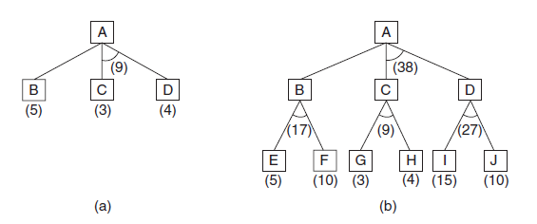
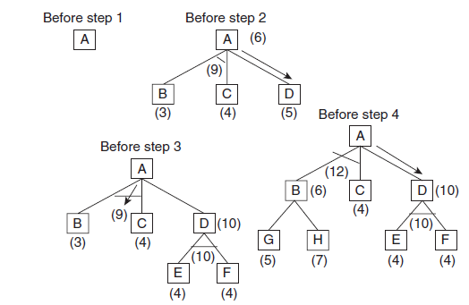
Example of AO*
5.1 Introduction
5.2 Hill Climbing
5.3 Best-first Search (Greedy Search)
5.4 A* Search
5.5 AO* Search: (AND–OR) Graph
5.6 Memory Bounded Heuristic Search
5.6.1 Iterative Deepening A*
5.6.2 Recursive BFS
5.6.3 Simplified Memory Bounded A* (SMA*)
5.7 Simulated Annealing Search
5.8 Local Beam Search
5.9 Branch and Bound Search
Thus, we can see that to search an
AND–OR graph, the following three things must be done.
1. Traverse the graph starting at the initial node and following the current best path, and accumulate the set of nodes that are on the path and have not yet been expanded.
2. Pick one of these unexpanded nodes and expand it. Add its successors to the graph and computer f ’ (cost of the remaining distance) for each of them.
3. Change the f ’ estimate of the newly expanded node to reflect the new information produced by
its successors. Propagate this change backward through the graph. Decide which of the current best path.

Slide 74
Difference between A* and AO* Algorithm
5.1 Introduction
5.2 Hill Climbing
5.3 Best-first Search (Greedy Search)
5.4 A* Search
5.5 AO* Search: (AND–OR) Graph
5.6 Memory Bounded Heuristic Search
5.6.1 Iterative Deepening A*
5.6.2 Recursive BFS
5.6.3 Simplified Memory Bounded A* (SMA*)
5.7 Simulated Annealing Search
5.8 Local Beam Search
5.9 Branch and Bound Search
A* algorithm
1. a* is a computer algorithm which is used in pathfinding and graph traversal. It is used in the process of plotting an efficiently directed path between a number of points called nodes.
2. In a* algorithm you traverse the tree in depth and keep moving and adding up the total cost of reaching the cost from the current state to the goal state and add it to the cost of reaching the current state.
AO* algorithm
1. In ao* algorithm you follow a similar procedure but there are constraints traversing specific paths.
2. When you traverse those paths, cost of all the paths which originate from the preceding node are added till that level, where you find the goal state regardless of the fact whether they take you to the goal state or not.

Slide 75
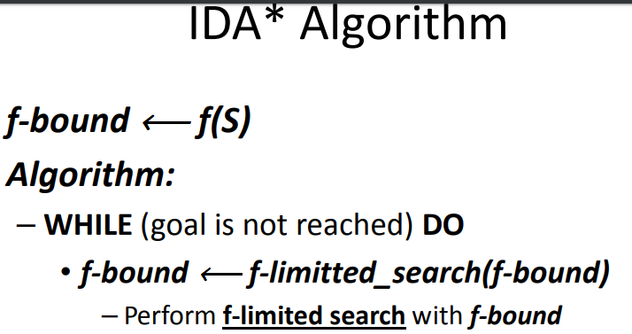
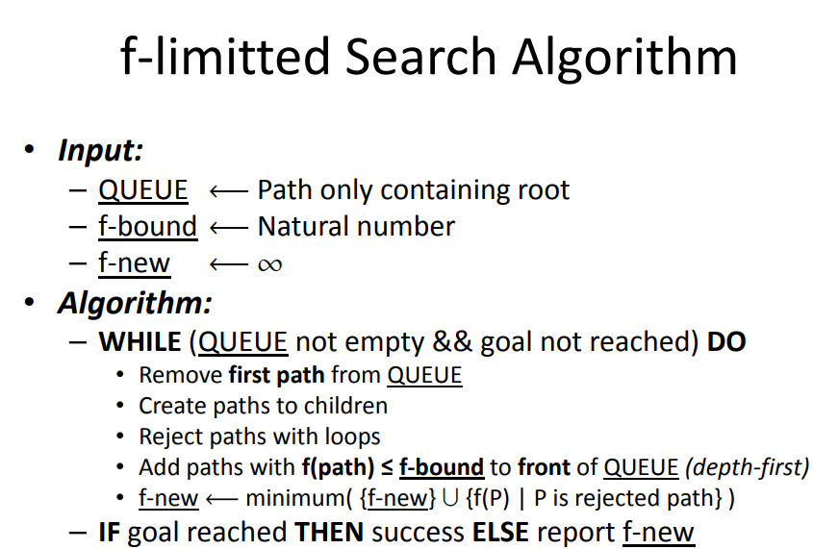
5.1 Introduction
5.2 Hill Climbing
5.3 Best-first Search (Greedy Search)
5.4 A* Search
5.5 AO* Search: (AND–OR) Graph
5.6 Memory Bounded Heuristic Search
5.6.1 Iterative Deepening A*
5.6.2 Recursive BFS
5.6.3 Simplified Memory Bounded A* (SMA*)
5.7 Simulated Annealing Search
5.8 Local Beam Search
5.9 Branch and Bound Search

Slide 76
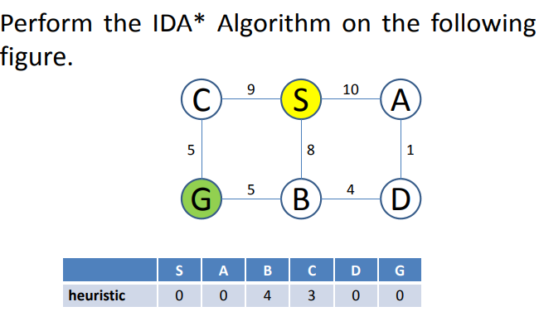
5.1 Introduction
5.2 Hill Climbing
5.3 Best-first Search (Greedy Search)
5.4 A* Search
5.5 AO* Search: (AND–OR) Graph
5.6 Memory Bounded Heuristic Search
5.6.1 Iterative Deepening A*
5.6.2 Recursive BFS
5.6.3 Simplified Memory Bounded A* (SMA*)
5.7 Simulated Annealing Search
5.8 Local Beam Search
5.9 Branch and Bound Search

Slide 77
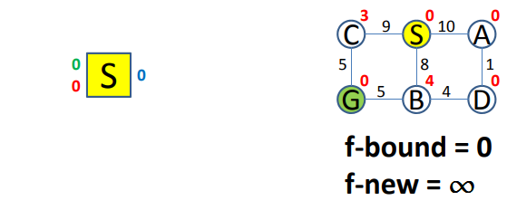
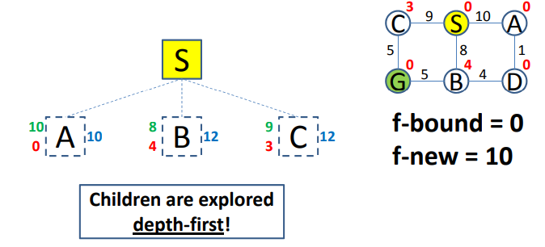
5.1 Introduction
5.2 Hill Climbing
5.3 Best-first Search (Greedy Search)
5.4 A* Search
5.5 AO* Search: (AND–OR) Graph
5.6 Memory Bounded Heuristic Search
5.6.1 Iterative Deepening A*
5.6.2 Recursive BFS
5.6.3 Simplified Memory Bounded A* (SMA*)
5.7 Simulated Annealing Search
5.8 Local Beam Search
5.9 Branch and Bound Search

Slide 78
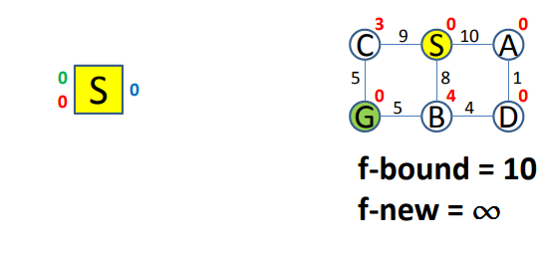

5.1 Introduction
5.2 Hill Climbing
5.3 Best-first Search (Greedy Search)
5.4 A* Search
5.5 AO* Search: (AND–OR) Graph
5.6 Memory Bounded Heuristic Search
5.6.1 Iterative Deepening A*
5.6.2 Recursive BFS
5.6.3 Simplified Memory Bounded A* (SMA*)
5.7 Simulated Annealing Search
5.8 Local Beam Search
5.9 Branch and Bound Search

Slide 79


5.1 Introduction
5.2 Hill Climbing
5.3 Best-first Search (Greedy Search)
5.4 A* Search
5.5 AO* Search: (AND–OR) Graph
5.6 Memory Bounded Heuristic Search
5.6.1 Iterative Deepening A*
5.6.2 Recursive BFS
5.6.3 Simplified Memory Bounded A* (SMA*)
5.7 Simulated Annealing Search
5.8 Local Beam Search
5.9 Branch and Bound Search

Slide 80


5.1 Introduction
5.2 Hill Climbing
5.3 Best-first Search (Greedy Search)
5.4 A* Search
5.5 AO* Search: (AND–OR) Graph
5.6 Memory Bounded Heuristic Search
5.6.1 Iterative Deepening A*
5.6.2 Recursive BFS
5.6.3 Simplified Memory Bounded A* (SMA*)
5.7 Simulated Annealing Search
5.8 Local Beam Search
5.9 Branch and Bound Search

Slide 81


5.1 Introduction
5.2 Hill Climbing
5.3 Best-first Search (Greedy Search)
5.4 A* Search
5.5 AO* Search: (AND–OR) Graph
5.6 Memory Bounded Heuristic Search
5.6.1 Iterative Deepening A*
5.6.2 Recursive BFS
5.6.3 Simplified Memory Bounded A* (SMA*)
5.7 Simulated Annealing Search
5.8 Local Beam Search
5.9 Branch and Bound Search

Slide 82


5.1 Introduction
5.2 Hill Climbing
5.3 Best-first Search (Greedy Search)
5.4 A* Search
5.5 AO* Search: (AND–OR) Graph
5.6 Memory Bounded Heuristic Search
5.6.1 Iterative Deepening A*
5.6.2 Recursive BFS
5.6.3 Simplified Memory Bounded A* (SMA*)
5.7 Simulated Annealing Search
5.8 Local Beam Search
5.9 Branch and Bound Search

Slide 83


5.1 Introduction
5.2 Hill Climbing
5.3 Best-first Search (Greedy Search)
5.4 A* Search
5.5 AO* Search: (AND–OR) Graph
5.6 Memory Bounded Heuristic Search
5.6.1 Iterative Deepening A*
5.6.2 Recursive BFS
5.6.3 Simplified Memory Bounded A* (SMA*)
5.7 Simulated Annealing Search
5.8 Local Beam Search
5.9 Branch and Bound Search

Slide 84


5.1 Introduction
5.2 Hill Climbing
5.3 Best-first Search (Greedy Search)
5.4 A* Search
5.5 AO* Search: (AND–OR) Graph
5.6 Memory Bounded Heuristic Search
5.6.1 Iterative Deepening A*
5.6.2 Recursive BFS
5.6.3 Simplified Memory Bounded A* (SMA*)
5.7 Simulated Annealing Search
5.8 Local Beam Search
5.9 Branch and Bound Search

Slide 85

5.1 Introduction
5.2 Hill Climbing
5.3 Best-first Search (Greedy Search)
5.4 A* Search
5.5 AO* Search: (AND–OR) Graph
5.6 Memory Bounded Heuristic Search
5.6.1 Iterative Deepening A*
5.6.2 Recursive BFS
5.6.3 Simplified Memory Bounded A* (SMA*)
5.7 Simulated Annealing Search
5.8 Local Beam Search
5.9 Branch and Bound Search

Slide 86
Memory Bounded Heuristic Search: Recursive BFS
5.1 Introduction
5.2 Hill Climbing
5.3 Best-first Search (Greedy Search)
5.4 A* Search
5.5 AO* Search: (AND–OR) Graph
5.6 Memory Bounded Heuristic Search
5.6.1 Iterative Deepening A*
5.6.2 Recursive BFS
5.6.3 Simplified Memory Bounded A* (SMA*)
5.7 Simulated Annealing Search
5.8 Local Beam Search
5.9 Branch and Bound Search
How can we solve the memory problem for A* search?
Idea: Try something like depth first search, but let’s not forget everything about the branches we have partially explored.
We remember the best f-value we have found so far in the branch we are deleting.

Slide 87

RBFS:
5.1 Introduction
5.2 Hill Climbing
5.3 Best-first Search (Greedy Search)
5.4 A* Search
5.5 AO* Search: (AND–OR) Graph
5.6 Memory Bounded Heuristic Search
5.6.1 Iterative Deepening A*
5.6.2 Recursive BFS
5.6.3 Simplified Memory Bounded A* (SMA*)
5.7 Simulated Annealing Search
5.8 Local Beam Search
5.9 Branch and Bound Search
best alternative
over fringe nodes,
which are not children:
do I want to back up?
RBFS changes its mind
very often in practice.
This is because the
f=g+h become more
accurate (less optimistic)
as we approach the goal.
Hence, higher level nodes
have smaller f-values and
will be explored first.
Problem: We should keep
in memory whatever we can.

Slide 88
Simple Memory Bounded A*
5.1 Introduction
5.2 Hill Climbing
5.3 Best-first Search (Greedy Search)
5.4 A* Search
5.5 AO* Search: (AND–OR) Graph
5.6 Memory Bounded Heuristic Search
5.6.1 Iterative Deepening A*
5.6.2 Recursive BFS
5.6.3 Simplified Memory Bounded A* (SMA*)
5.7 Simulated Annealing Search
5.8 Local Beam Search
5.9 Branch and Bound Search
This is like A*, but when memory is full we delete the worst node (largest f-value).
Like RBFS, we remember the best descendent in the branch we delete.
If there is a tie (equal f-values) we first delete the oldest nodes first.
simple-MBA* finds the optimal reachable solution given the memory constraint.
Time can still be exponential.

Slide 89

Perform SMA* (memory: 3 nodes) on the following figure.
5.1 Introduction
5.2 Hill Climbing
5.3 Best-first Search (Greedy Search)
5.4 A* Search
5.5 AO* Search: (AND–OR) Graph
5.6 Memory Bounded Heuristic Search
5.6.1 Iterative Deepening A*
5.6.2 Recursive BFS
5.6.3 Simplified Memory Bounded A* (SMA*)
5.7 Simulated Annealing Search
5.8 Local Beam Search
5.9 Branch and Bound Search

Slide 90


5.1 Introduction
5.2 Hill Climbing
5.3 Best-first Search (Greedy Search)
5.4 A* Search
5.5 AO* Search: (AND–OR) Graph
5.6 Memory Bounded Heuristic Search
5.6.1 Iterative Deepening A*
5.6.2 Recursive BFS
5.6.3 Simplified Memory Bounded A* (SMA*)
5.7 Simulated Annealing Search
5.8 Local Beam Search
5.9 Branch and Bound Search

Slide 91


5.1 Introduction
5.2 Hill Climbing
5.3 Best-first Search (Greedy Search)
5.4 A* Search
5.5 AO* Search: (AND–OR) Graph
5.6 Memory Bounded Heuristic Search
5.6.1 Iterative Deepening A*
5.6.2 Recursive BFS
5.6.3 Simplified Memory Bounded A* (SMA*)
5.7 Simulated Annealing Search
5.8 Local Beam Search
5.9 Branch and Bound Search

Slide 92


5.1 Introduction
5.2 Hill Climbing
5.3 Best-first Search (Greedy Search)
5.4 A* Search
5.5 AO* Search: (AND–OR) Graph
5.6 Memory Bounded Heuristic Search
5.6.1 Iterative Deepening A*
5.6.2 Recursive BFS
5.6.3 Simplified Memory Bounded A* (SMA*)
5.7 Simulated Annealing Search
5.8 Local Beam Search
5.9 Branch and Bound Search

Slide 93


5.1 Introduction
5.2 Hill Climbing
5.3 Best-first Search (Greedy Search)
5.4 A* Search
5.5 AO* Search: (AND–OR) Graph
5.6 Memory Bounded Heuristic Search
5.6.1 Iterative Deepening A*
5.6.2 Recursive BFS
5.6.3 Simplified Memory Bounded A* (SMA*)
5.7 Simulated Annealing Search
5.8 Local Beam Search
5.9 Branch and Bound Search

Slide 94


5.1 Introduction
5.2 Hill Climbing
5.3 Best-first Search (Greedy Search)
5.4 A* Search
5.5 AO* Search: (AND–OR) Graph
5.6 Memory Bounded Heuristic Search
5.6.1 Iterative Deepening A*
5.6.2 Recursive BFS
5.6.3 Simplified Memory Bounded A* (SMA*)
5.7 Simulated Annealing Search
5.8 Local Beam Search
5.9 Branch and Bound Search

Slide 95

5.1 Introduction
5.2 Hill Climbing
5.3 Best-first Search (Greedy Search)
5.4 A* Search
5.5 AO* Search: (AND–OR) Graph
5.6 Memory Bounded Heuristic Search
5.6.1 Iterative Deepening A*
5.6.2 Recursive BFS
5.6.3 Simplified Memory Bounded A* (SMA*)
5.7 Simulated Annealing Search
5.8 Local Beam Search
5.9 Branch and Bound Search

Slide 96
Annealing
5.1 Introduction
5.2 Hill Climbing
5.3 Best-first Search (Greedy Search)
5.4 A* Search
5.5 AO* Search: (AND–OR) Graph
5.6 Memory Bounded Heuristic Search
5.6.1 Iterative Deepening A*
5.6.2 Recursive BFS
5.6.3 Simplified Memory Bounded A* (SMA*)
5.7 Simulated Annealing Search
5.8 Local Beam Search
5.9 Branch and Bound Search
Annealing is a thermal process for obtaining low energy states of a solid in a heat bath.
The process contains two steps:
Increase the temperature of the heat bath to a maximum value at which the solid melts.
Decrease carefully the temperature of the heat bath until the particles arrange themselves in the ground state of the solid. Ground state is a minimum energy state of the solid.
The ground state of the solid is obtained only if the maximum temperature is high enough and the cooling is done slowly.

Slide 97
Simulated Annealing
5.1 Introduction
5.2 Hill Climbing
5.3 Best-first Search (Greedy Search)
5.4 A* Search
5.5 AO* Search: (AND–OR) Graph
5.6 Memory Bounded Heuristic Search
5.6.1 Iterative Deepening A*
5.6.2 Recursive BFS
5.6.3 Simplified Memory Bounded A* (SMA*)
5.7 Simulated Annealing Search
5.8 Local Beam Search
5.9 Branch and Bound Search
The process of annealing can be simulated with the Metropolis algorithm, which is based on Monte Carlo techniques.
We can apply this algorithm to generate a solution to combinatorial optimization problems assuming an analogy between them and physical many-particle systems with the following equivalences:
Solutions in the problem are equivalent to states in a physical system.
The cost of a solution is equivalent to the “energy” of a state.

Slide 98
Simulated Annealing
5.1 Introduction
5.2 Hill Climbing
5.3 Best-first Search (Greedy Search)
5.4 A* Search
5.5 AO* Search: (AND–OR) Graph
5.6 Memory Bounded Heuristic Search
5.6.1 Iterative Deepening A*
5.6.2 Recursive BFS
5.6.3 Simplified Memory Bounded A* (SMA*)
5.7 Simulated Annealing Search
5.8 Local Beam Search
5.9 Branch and Bound Search
To apply simulated annealing with optimization purposes we require the following:
A successor function that returns a “close” neighboring solution given the actual one. This will work as the “disturbance” for the particles of the system.
A target function to optimize that depends on the current state of the system. This function will work as the energy of the system.
The search is started with a randomized state. In a polling loop we will move to neighboring states always accepting the moves that decrease the energy while only accepting bad moves accordingly to a probability distribution dependent on the “temperature” of the system.

Slide 99

Simulated Annealing
5.1 Introduction
5.2 Hill Climbing
5.3 Best-first Search (Greedy Search)
5.4 A* Search
5.5 AO* Search: (AND–OR) Graph
5.6 Memory Bounded Heuristic Search
5.6.1 Iterative Deepening A*
5.6.2 Recursive BFS
5.6.3 Simplified Memory Bounded A* (SMA*)
5.7 Simulated Annealing Search
5.8 Local Beam Search
5.9 Branch and Bound Search
Decrease the temperature slowly, accepting less bad moves at each temperature level until at very low temperatures the algorithm becomes a greedy hill-climbing algorithm.
The distribution used to decide if we accept a bad movement is know as Boltzman distribution.
This distribution is very well known is in solid physics and plays a central role in simulated annealing. Where γ is the current configuration of the system, E _{γ} is the energy related with it, and Z is a normalization constant.

Slide 100
Simulated Annealing: the code
5.1 Introduction
5.2 Hill Climbing
5.3 Best-first Search (Greedy Search)
5.4 A* Search
5.5 AO* Search: (AND–OR) Graph
5.6 Memory Bounded Heuristic Search
5.6.1 Iterative Deepening A*
5.6.2 Recursive BFS
5.6.3 Simplified Memory Bounded A* (SMA*)
5.7 Simulated Annealing Search
5.8 Local Beam Search
5.9 Branch and Bound Search
function Simulated-Annealing (problem, schedule)
returns a solution state
inputs: problem, a problem
schedule, a mapping from time to “temperature”
local variables: current, a node next, a node T, the temperature
current ← MakeNode (RandomState[problem])
for t ← 1 to ∞ do
T ← schedule [t]
if T = 0 then return current
next ← a randomly selected successor of current
ΔE ← Value [next] - Value [current]
if ΔE > 0 then current ← next
else current ← next only with probability eΔE/T

Slide 101
Practical Issues with simulated annealing
5.1 Introduction
5.2 Hill Climbing
5.3 Best-first Search (Greedy Search)
5.4 A* Search
5.5 AO* Search: (AND–OR) Graph
5.6 Memory Bounded Heuristic Search
5.6.1 Iterative Deepening A*
5.6.2 Recursive BFS
5.6.3 Simplified Memory Bounded A* (SMA*)
5.7 Simulated Annealing Search
5.8 Local Beam Search
5.9 Branch and Bound Search
The cost function should be fast it is going to be called “millions” of times.
The best is if we just have to calculate the deltas produced by the modification instead of traversing through all the state.
This is dependent on the application.

Slide 102
Local search algorithms
5.1 Introduction
5.2 Hill Climbing
5.3 Best-first Search (Greedy Search)
5.4 A* Search
5.5 AO* Search: (AND–OR) Graph
5.6 Memory Bounded Heuristic Search
5.6.1 Iterative Deepening A*
5.6.2 Recursive BFS
5.6.3 Simplified Memory Bounded A* (SMA*)
5.7 Simulated Annealing Search
5.8 Local Beam Search
5.9 Branch and Bound Search
In many optimization problems, the path to the goal is irrelevant; the goal state itself is the solution
State space = set of "complete" configurations
Find configuration satisfying constraints, e.g., n-queens
In such cases, we can use local search algorithms
keep a single "current" state, try to improve it.
Very memory efficient (only remember current state)

Slide 103

Example: n-queens
5.1 Introduction
5.2 Hill Climbing
5.3 Best-first Search (Greedy Search)
5.4 A* Search
5.5 AO* Search: (AND–OR) Graph
5.6 Memory Bounded Heuristic Search
5.6.1 Iterative Deepening A*
5.6.2 Recursive BFS
5.6.3 Simplified Memory Bounded A* (SMA*)
5.7 Simulated Annealing Search
5.8 Local Beam Search
5.9 Branch and Bound Search
Put n queens on an n × n board with no two queens on the same row, column, or diagonal
Note that a state cannot be an incomplete configuration with m<n queens

Slide 104
Branch and Bound Search
5.1 Introduction
5.2 Hill Climbing
5.3 Best-first Search (Greedy Search)
5.4 A* Search
5.5 AO* Search: (AND–OR) Graph
5.6 Memory Bounded Heuristic Search
5.6.1 Iterative Deepening A*
5.6.2 Recursive BFS
5.6.3 Simplified Memory Bounded A* (SMA*)
5.7 Simulated Annealing Search
5.8 Local Beam Search
5.9 Branch and Bound Search
Branch and Bound is an algorithmic technique which finds the optimal solution by keeping the best solution found so far. If partial solution can’t improve on the best it is abandoned, by this method the number of nodes which are explored can also be reduced. It also deals with the optimization problems over a search that can be presented as the leaves of the search tree. The usual technique for eliminating the sub trees from the search tree is called pruning. For Branch and Bound algorithm we will use stack data structure.
Step 1: Traverse the root node.
Step 2: Traverse any neighbour of the root node that is maintaining least distance from the root node.
Step 3: Traverse any neighbour of the neighbour of the root node that is maintaining least distance from the root node.

